Slide 1

Searching for universality
Robert Miller
Steward @ Flashbots

Slide 2

Traveling back to the salon that was Flashbots in 2021…

Slide 3
MEV is fundamental
Ability to commit: commitments alter the incentives of the parties ordering transactions
Permissionlessness as a design pattern: permissionless commitments are a fundamental part of building permissionless systems
Multiple domains: the boundaries between domains create value extraction opportunities
Source: Phil’s MEV wat do
Notes:
These hold regardless of a chain’s design choices (ordering scheme, VM, speed, etc). Which means it has and needs to deal with MEV.

Slide 4
MEV has negative effects
Rational actors pursuing their incentives can create negative externalities in their wake:
Wasted blockspace and networking load
Consensus instability
Economic centralization
Sandwiching
etc
Notes:
Wasted block space / networking load -> PGAs, latency, spam

Slide 5
We have solutions for much of these negative effects
We can (and have) mitigated negative externalities of MEV with centralized infrastructure
mev-boost, builders, mev-share, Flashbots Protect, centralized RFQs, etc…

Slide 6
Centralization is not a solution
However, centralized infrastructure…
Does not scale well technically or socially
Provides an avenue for censorship
Needs constant policing and data due to trust needed
Has centralizing pressure from exclusive orderflow

Slide 7
Searching for universality
MEV is fundamental → MEV will show up in every domain
MEV has negative effects → We should mitigate these
MEV can be mitigated by centralized tech → Does not scale & poses systemic risks
How do we decentralize MEV infrastructure? How do we do so in a way that can scale to many heterogeneous domains (is “universal”)?

Slide 8
The MEV supply chain (Utopia)
$$$
$$$
$$$
$$$
User
Wallet
Searcher
Builder
Validator
User
Wallet
Searcher
Builder
Validator
User
Wallet
Searcher
Builder
Validator
Intent
Transaction
Bundle
Block
Let’s start with what we want out of the MEV supply chain:
Specialization
Maximum competition
No privileged actors

Slide 9
The MEV supply chain (Dystopia)
MEV MegaFund Blackbox
User
What we don’t want out of the MEV supply chain:
Vertical integration
Censorship
Rent extraction

Slide 10
Moving closer to Utopia
$$$
$$$
$$$
$$$
User
Wallet
Searcher
Builder
Validator
User
Wallet
Searcher
Builder
Validator
User
Wallet
mev-share
Searcher
Builder
mev-boost
Validator
Intent
Transaction
Bundle
Block
Protocols like mev-share and mev-boost enable collaboration among otherwise untrusted parties, preventing the supply chain from collapsing
How?
Privacy
Commitments

Slide 11
Privacy and commitments
 | Collaboration between | Privacy | Commitments
mev-boost | Builders and validators | Block bodies hidden from validators to prevent MEV stealing | Builders commit via sending blocks to relays Proposers commit by signing block headers
mev-share | Users and searchers | Selective data sharing on users’ txs to prevent frontrunning but allow optimization | Searchers commit by sending optimistic backruns Builders commit to refund users
Both rely on an intermediary for privacy and commitment devices

Slide 12
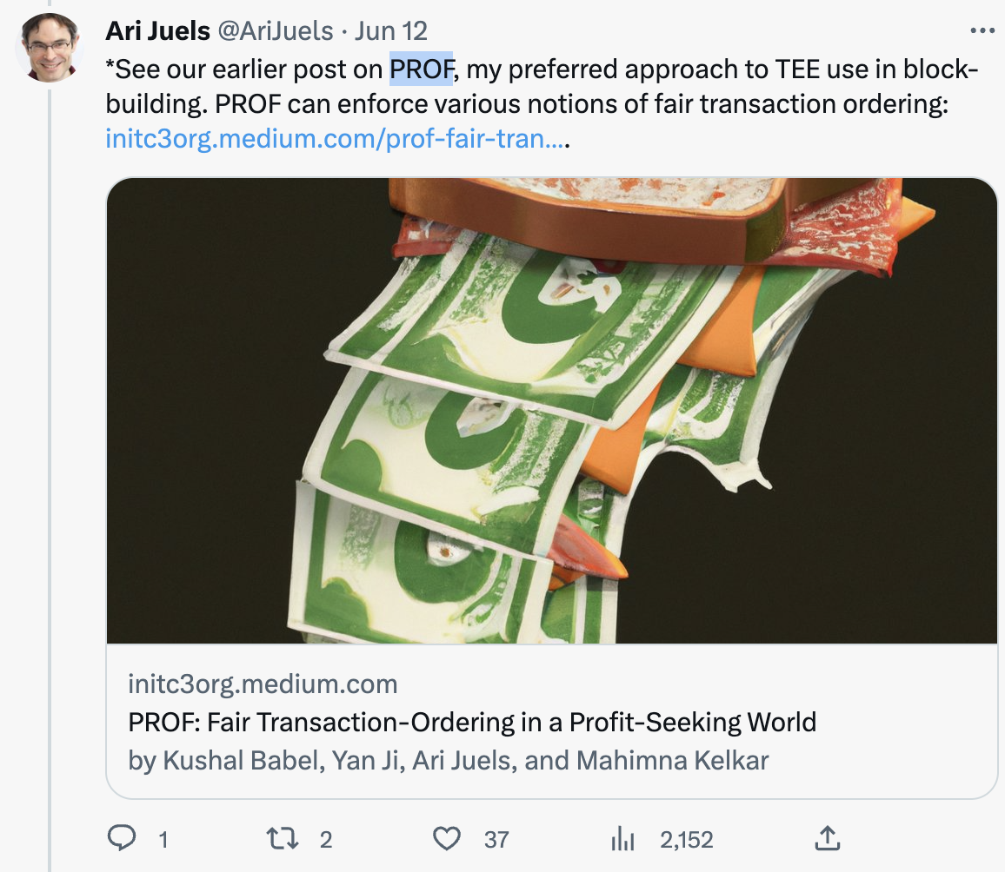
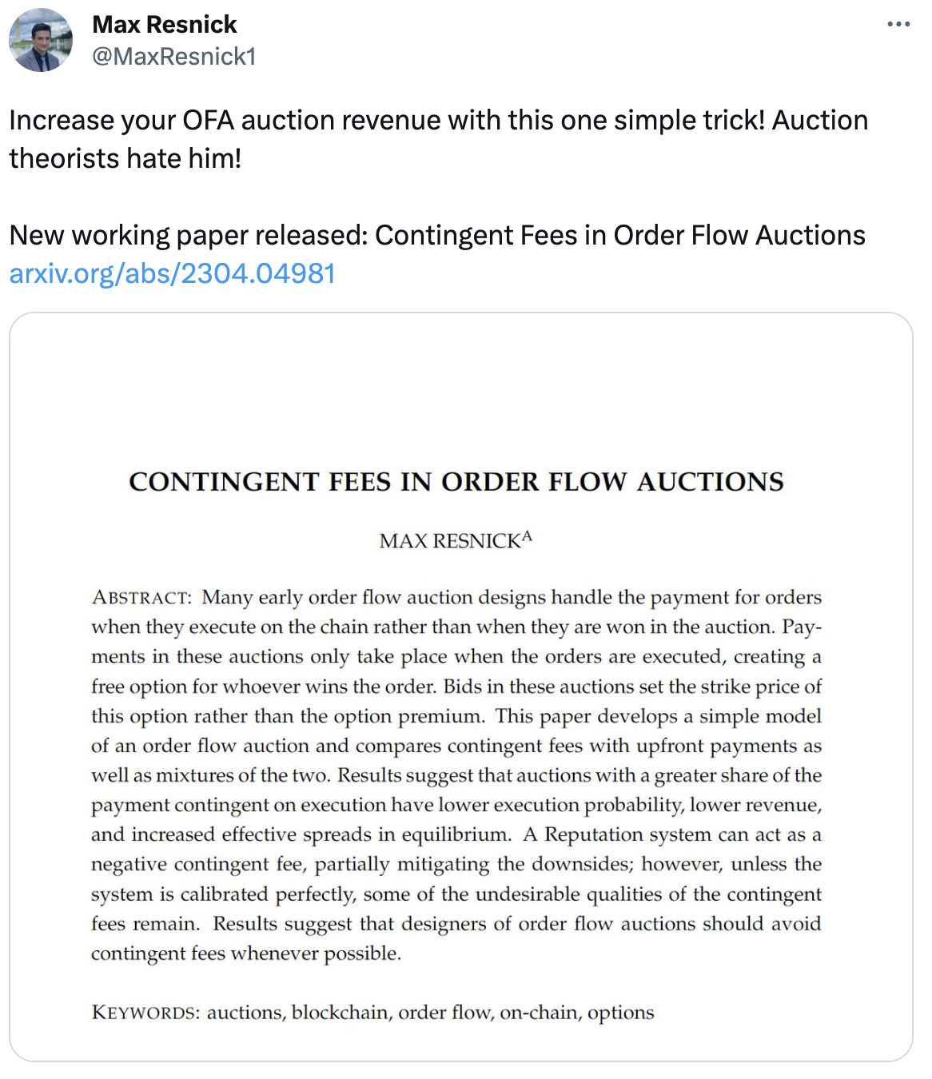


There are many new mechanism out there
Many new mechanisms have popped up in the MEV market
All rely in some way on the core primitives of privacy and commitments
Bootstraping the trust needed to gain adoption is very difficult
Policing these is very difficult

Slide 13
Towards a unified MEV supply chain infrastructure
Cooperation in the MEV supply chain breaks down without trust and privacy
We can use privacy and commitments to remove the need for trust between parties
Bootstraping trust in the credibility of your mechanism is a key challenge for new entrants

Slide 14
SUAVE
SUAVE: a decentralized platform for MEV applications that provides credible privacy and commitments
Developers can use SUAVE to program MEV applications as smart contracts
SUAVE uses the MEVM, a modified EVM, to expose new MEV precompiles for privacy and other MEV use case needs

Slide 15
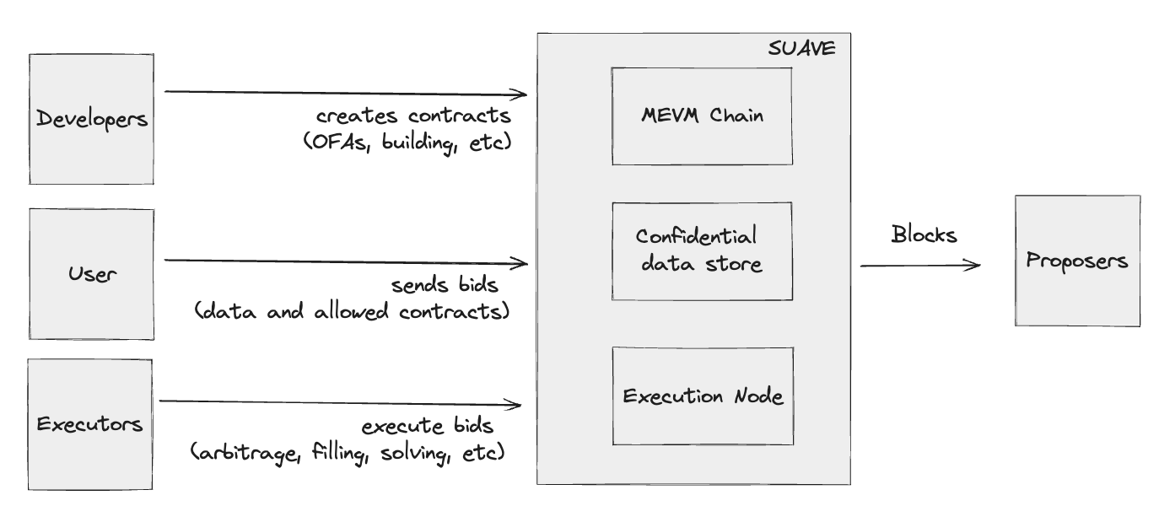
SUAVE architecture with the MEVM

Slide 16
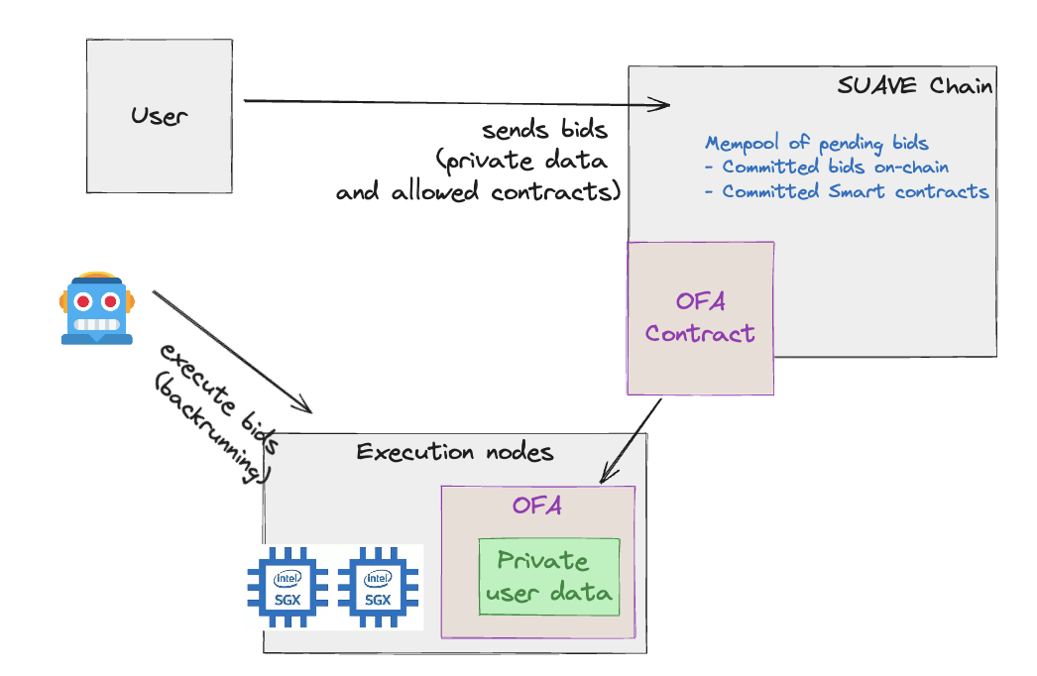
Execution nodes
Smart contracts define off-chain execution that is performed inside execution nodes
Execution nodes have access to private data
Execution nodes run inside of trusted execution environments to provide privacy and credibility to compute

Slide 17
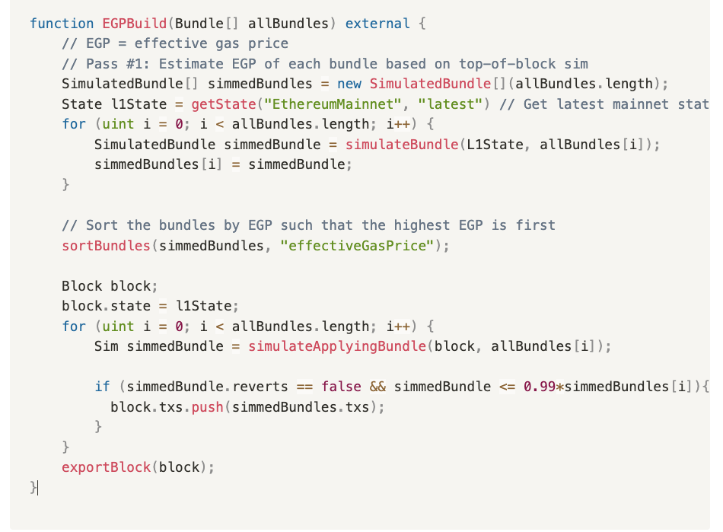
Example MEVM Contract

Slide 18
Other potential MEVM contracts
New building algorithms
New types of DEXes
Pre-confirmations
UniswapX
CoWSwap
MEV-Share
Distributed building
Composing the above
… etc

Slide 19
SUAVE as a Market
SUAVE is a decentralized platform for MEV applications
SUAVE will drastically lower the barrier to experimenting in the block building market and open access to orderflow in particular
MEV applications compete and compose together in an open market for innovation, resulting in better outcomes for users and better blocks for validators
Bundle merging by EGP
Bundle merging by total profit
Backrun auction Contracts
MEV-Share Node A
New OFA
PROF

Slide 20
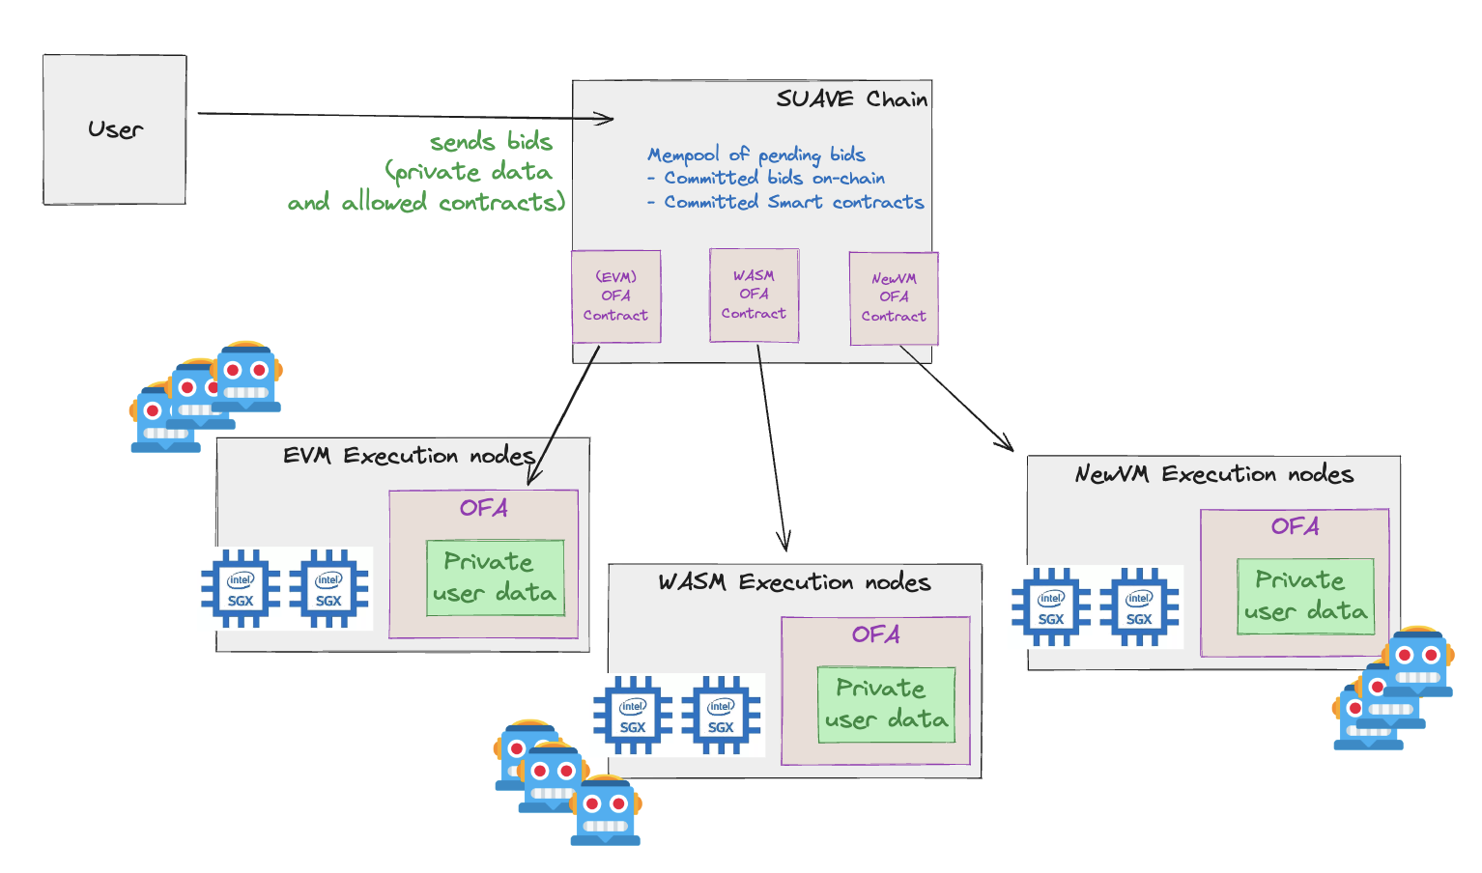
Other domains and SUAVE
To use SUAVE for ordering a domain needs:
PBS
An execution node for your domain
A smart contract for that domain

Slide 21
The ideal searcher game
Commitments on SUAVE can be arbitrarily complicated
These can unlock new searching strategies that address MEV and user driven use cases on non-PBS domains
Examples:
Spam: “I will pay 1 ETH to anyone who calls contract 0xCALL_ME and it emits a log”
X-Domain: “I will pay 1 ETH for X state on Ethereum and Y state on Arbitrum”
New Domain: “I will pay 1 ETH for X state on NEW_DOMAIN”
Swap: “I want to buy X asset with Y asset on Z chain”

Slide 22
tl;dr
MEV exists on all domains (“universality”) and should be mitigated
To do so we need privacy and commitment devices
Centralized infra has sufficed thus far but we need to replace this with decentralized infra for scale and robustness
Flashbots is building SUAVE: a decentralized platform that provides credible privacy and commitments for MEV applications across many heterogenous domains

Slide 23

Thank you!
Please reach out if you are a:
Rollup interested in integrating
Developer interested in deploying contracts
Wallet/dApp interested in MEV redistribution for your users
Searcher interested in searching on private OF
@bertcmiller on Twitter

